Slide 1
Statistical Learning
Gradient Descent for Logistic Regression
Tomas Karpati MD tc.datascience@gmail.com
054-2002430

Slide 2
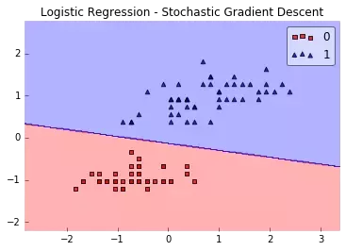
Classification Models
z = w₁x₁+ w₂x₂+ b

Slide 3
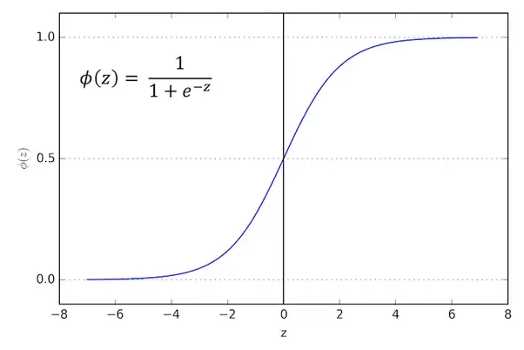
Logistic Regression
Logistic Models
The formula of logistic regression is:
z = w^{T}x ŷ = 𝛔(z) P(y=1| x)
The sigmoid function is defined as follows:
1
𝛔(Z) =
1 + e^{-Z}

Slide 4
Logistic Regression
Cost Function for Logistic Regression
- 𝞢(ylogŷ + (1-y)log(1-ŷ))
J(w,b) =
n
y = 0
y = 1

Slide 5
Gradient Descent
Cost (loss) function
Log Loss
J_{ỹ,y} = 1/N 𝞢L_{(ỹ,y)}
L_{(ỹ,y)} = -ylog(ỹ) + (1-y)log(1-ỹ)
𝒹 J
𝒹 w
𝒹 L
𝒹 z
𝒹 L
𝒹 z
𝒹 L
𝒹 ỹ
𝒹 ỹ
𝒹 z
W_{new}= W_{old} - 𝛼 x ->
= .
𝒹 L
𝒹 ỹ
= (-ylog(ỹ))’+ ((1-y)log(1-ỹ))’
𝒹 ỹ
𝒹 z
=
𝒹
𝒹 z
1
(1+ e^{-z})
𝒹 L
𝒹 ỹ
y
ỹ
(1-y)
(1-ỹ)
𝒹 ỹ
𝒹 z
1 e^{-z}
1+e^{-z} 1+e^{-z}
= - +
= . = (ỹ.(1-ỹ))
𝒹 L
𝒹 z
y
ỹ
(1-y)
(1-ỹ)
. (ỹ.(1-ỹ)) = ỹ - y
W_{new}= W_{old} - 𝛼 (ỹ - y).x
= - +

Slide 6
Logistic Regression
Error
Global minima
(convergence)
Learning rate
Weight

Slide 7
Gradient Descent
Logistic Model
Linear Model
Cost Function
Gradient Desc
ŷ = 1/(1+e^{-wTx})
ŷ = w^{T}x
loss = - 𝞢(ylogŷ + (1-y)log(1-ŷ))/ n
loss = 𝞢((y - ŷ)²) / n
grad = 𝞢((y - ŷ)*x)/n
theta = [random, random]
cost = loss(x, y, theta)
For iter in 1:max_iter
return(theta)
theta_new = theta - learning_rate * grad(x, y, theta)
cost_new = loss(x, y, theta_new)
If (cost_new > cost)
Break
theta = theta_new
cost = cost_new

Slide 8
Regularization
Regularization
Shrinks the parameters toward zero by penalizing large weights
Large lambda: optimize for lower weights more than for lower error
Regularization term is independent of the data
Try to balance between bias and variance

Slide 9
Regularization
L2 regularization = Ridge Regression
Penalized weights tend to approximate zero
m = m - ((error * x * 𝛂) + (𝛌 * m²))
b = b - (error * 𝛂)

Slide 10
Regularization
L1 regularization = LASSO Regression
Penalized weights may be zeroed.
m = m - ((error * x * 𝛂) + (𝛌 * |m|))
b = b - (error * 𝛂)

Slide 11
Regularization
L1/L2 regularization = ElasticNet
Penalized weights may be zeroed or may approximate zero.
m = m - ((error * x * 𝛂) + (𝛌₁ * |m|) + (𝛌₂ * m²))
b = b - (error * 𝛂)

